Slide 1

Internet Information Services
Iliyan Murdanliev
National Academy for Software Development
academy.devbg.org

Slide 2

Contents
What is IIS
Publishing a web site in IIS
  Creating a virtual directory
  Setting permissions
Notes:
<number>##
<footer>*
<header>*
<date/time>07/16/96

Slide 3
What is IIS
IIS is a set of internet-based services for servers running on Windows
Allows hosting sites on the internet
Freely distributed with Windows
  IIS 5.1 with Windows XP
  IIS 6.0 with Windows Server 2003 and Windows XP Professional x64 Edition
  IIS 7.0 with Windows Vista and Windows Server 2008
Notes:
<number>##
<footer>*
<header>*
<date/time>07/16/96

Slide 4
IIS 5.1
IIS 5.1 is freely available with Windows XP but you have some limitations
  You're limited to one web site
  You're limited to 10 simultaneous connections
It is not installed by default
  If you don't have it installed you need your Windows XP CD to install it
Notes:
<number>##
<footer>*
<header>*
<date/time>07/16/96

Slide 5
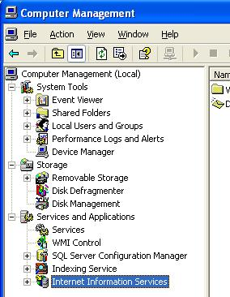
IIS 5.1- Installed?
How to check if it's installed?
  Check if "C:\Inetpub" exists (default)
My Computer => Manage – see if there is a section "Internet Information Services" under "Services and Applications"
See if the following opens a window – Start Menu =>Run => inetmgr
Notes:
<number>##
<footer>*
<header>*
<date/time>07/16/96

Slide 6
Publishing a Web Site with IIS

Slide 7
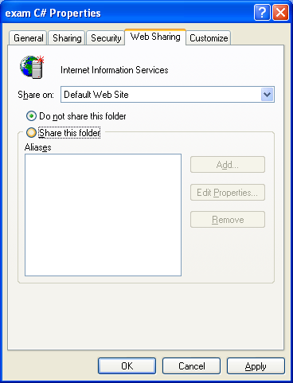
Publishing With IIS
The easiest way to do it is by right clicking your website folder
Go to the Web Sharing tab
Click on Share this folder
A dialog with options will pop up
Notes:
<number>##
<footer>*
<header>*
<date/time>07/16/96

Slide 8
IIS Virtual Dorectories
This marks the directory as a virtual directory on the server
Virtual directory
  It has a path (location) in the file system
  It has another path on the server
    Possibly different name
    In order to rename the virtual directory you have to delete it and then create it again
Notes:
<number>##
<footer>*
<header>*
<date/time>07/16/96

Slide 9
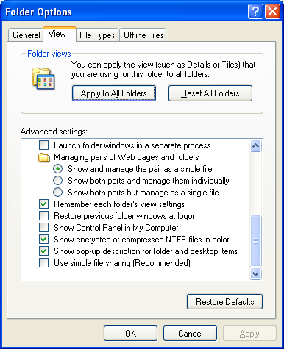
IIS Permissions
In order for the site to be available you need to set some permissions
You must disable simple file sharing first
  In Windows Explorer => Tools menu => View tab
  Uncheck the last checkbox
Notes:
<number>##
<footer>*
<header>*
<date/time>07/16/96

Slide 10
IIS Permissions (2)
When a user tries to access some resource on IIS he makes a request to it
When the target of the request is an ASP.Net page IIS transfers execution of the request to the ASP.Net worker process
  Aspnet_wp.exe – it runs under the default machine account ASPNET
  You must provide read permissions for that account to the folder of your site
Notes:
<number>##
<footer>*
<header>*
<date/time>07/16/96

Slide 11
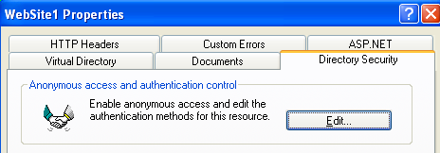
IIS Permissions (3)
Even though the ASPNET account has access to the resources the user trying to open it may not
Under the default settings ASPNET will open a dialog box asking for username and password
You can set an anonymous account to incoming requests
Notes:
<number>##
<footer>*
<header>*
<date/time>07/16/96

Slide 12
IIS Permissions (4)
You must give read permissions to the account you set for anonymous access
This will allow users accessing your web pages to be authorized automatically
If your website accesses a database it will access it with the ASPNET account
  Be sure to give this account permissions for the database
Notes:
<number>##
<footer>*
<header>*
<date/time>07/16/96

Slide 13
Publishing a Web Site
Live Demo

Slide 14
Configuring the Default Website

Slide 15
Site Settings
The content the user sees in his browser doesn't necessarily come from a local folder
  You have the option of redirecting to a shared resource on the network
  You can also redirect to another URL
Notes:
<number>##
<footer>*
<header>*
<date/time>07/16/96

Slide 16
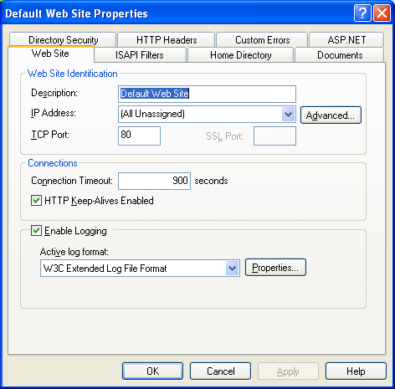
Site Settings
If you right click the default website you can set the IP, port, domain etc. of the website
Under the default
settings the web site
listens on all available
Ethernet controllers
on port 80
Notes:
<number>##
<footer>*
<header>*
<date/time>07/16/96

Slide 17
Different Versions of IIS

Slide 18
IIS Versions
IIS 5.1 is not practical for business use
  Restrictions
IIS 6.0 doesn't have those limitations
  Improved process isolation architecture
  Supports IPv6
IIS 7.0
  Simplified Deployment and Configuration
  Improved Security
  Enables user defined modules to handle every step of HTTP request handling
Notes:
<number>##
<footer>*
<header>*
<date/time>07/16/96

Slide 19
Internet Information Services
Questions?

Slide 20
Exercises
Host a simple HTML Site in IIS. Does it need the ASPNET account permissions?
Notes:
<number>##
<footer>*
<header>*
<date/time>07/16/96

